Slide 1
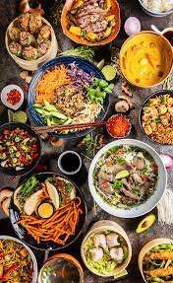
Project 1 group 5 Hungry group ☺
Zalak Shah
Sandra Reyes
Marisa Duong

Slide 2
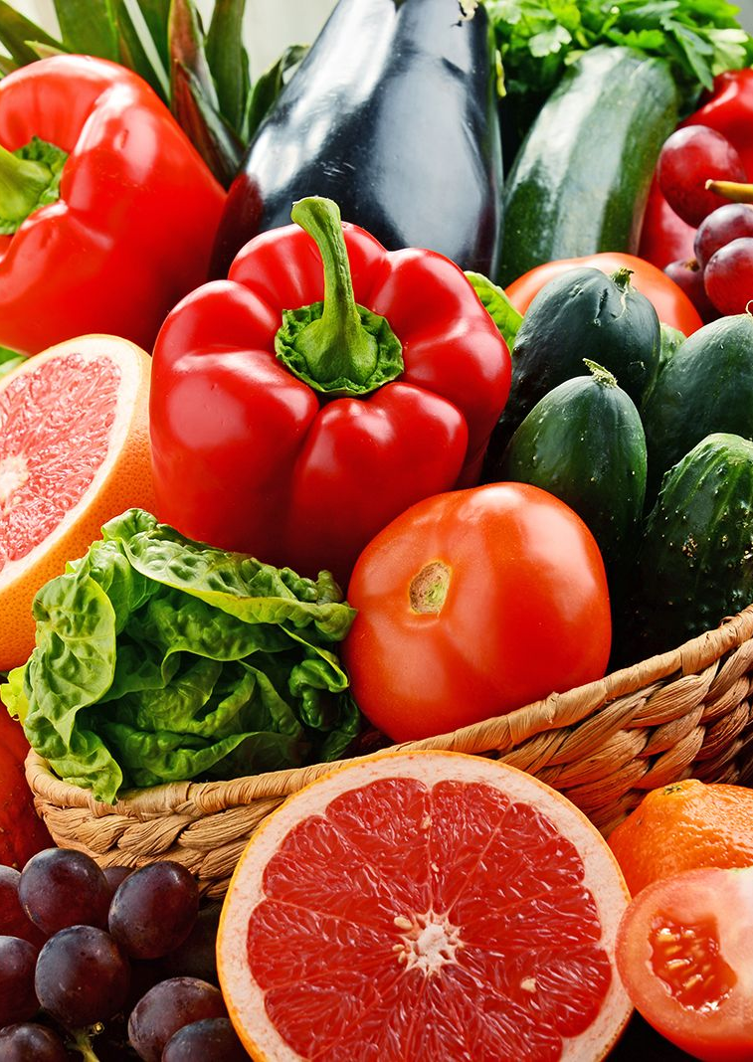
Imagine going home after work, tired and hungry…
And you only want to spend 30 minutes to cook.
Your family/housemates or some guests you’re hosting feel like some fancy international food.
You have tomato, onions and carrots that are about to be rotten so need to be used…
How can you become the master chef of your household?
→ Check out our Project ☺

Slide 3
What's for Dinner?
Aim of project: Easily search recipes by entering:
Preferred cuisine
Time available to cook
Ingredients available in the fridge
Dietary requirements (vegetarian, vegan)

Slide 4
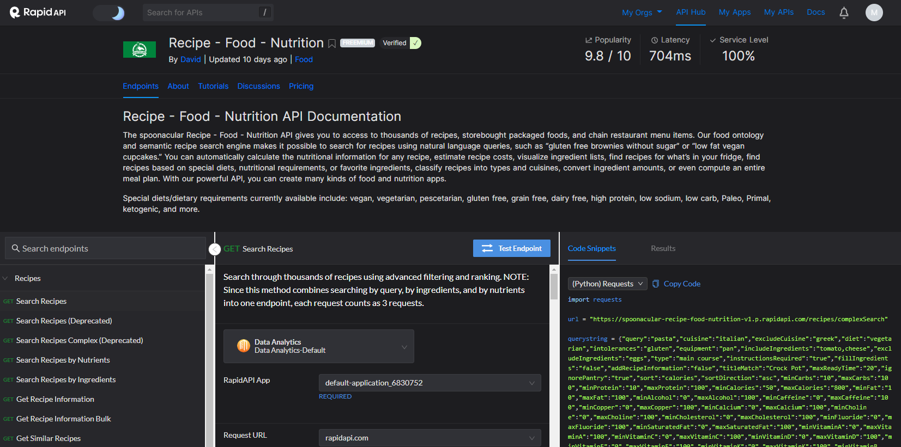
Database

Slide 5

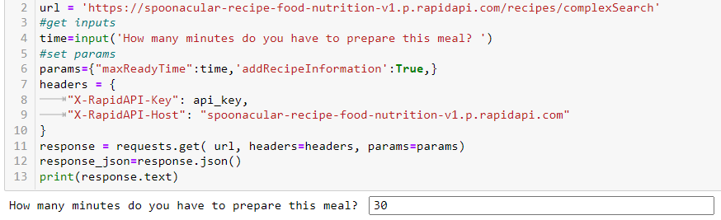
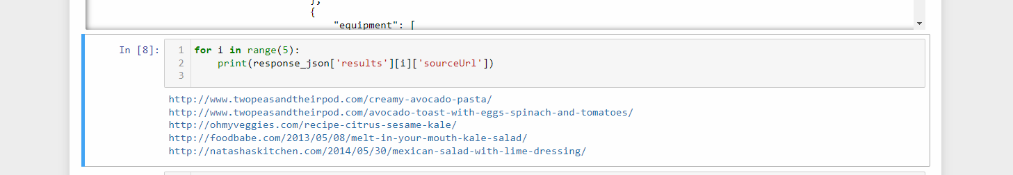
Time limitation

Slide 6
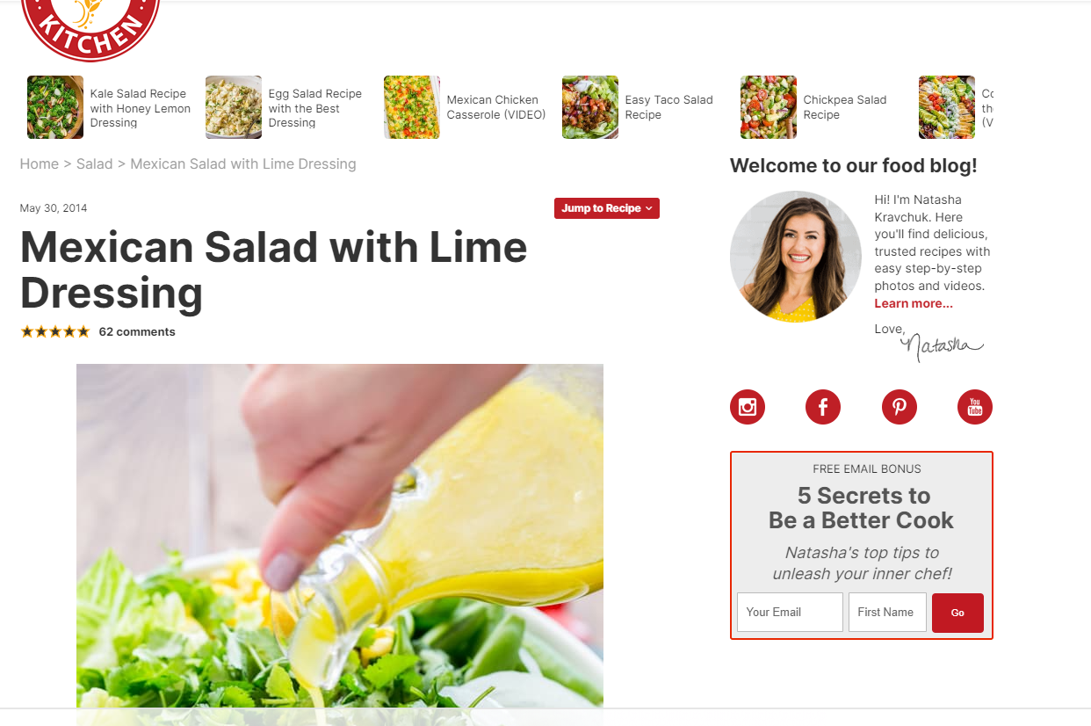

Slide 7
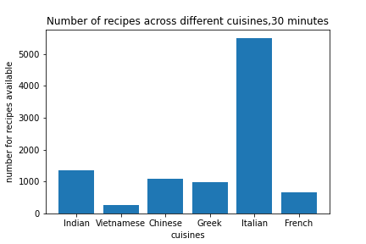

How many recipes are available for different cuisines?

Slide 8



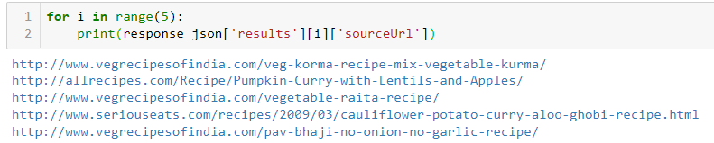
What’s in the fridge?

Slide 9
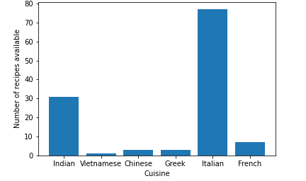
How many recipes are available for different cuisines?
Number of recipes across different cuisines that include tomato, onion and carrot

Slide 10
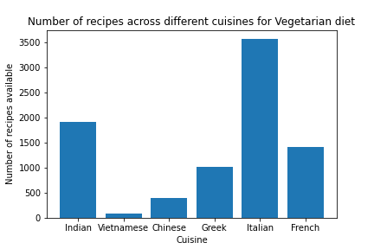
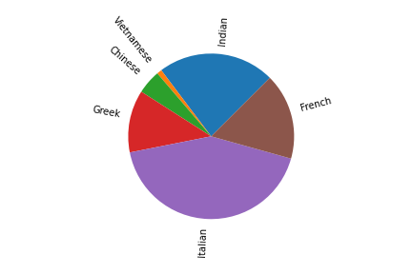
Special diets for our guests

Slide 11
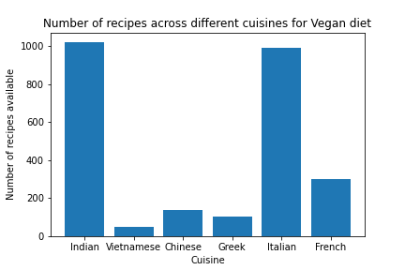
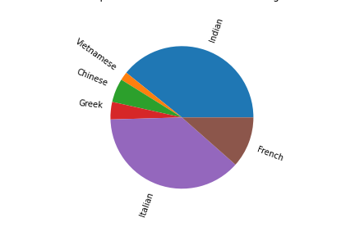
Special diets for our guests

Slide 12

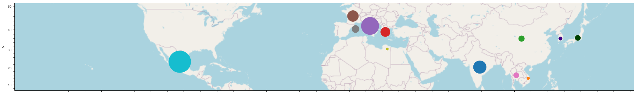
Looking at a few more countries
Dot size = Number of vegetarian recipes

Slide 13
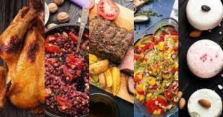
Conclusion
Main:
Purpose achieved: we can input time/ingredients/diets and get our recipes info.
Most popular cuisine is Italian (based on the number of recipes available in this database)
Side comments:
There are many Italian recipes available for time-poor hungry vegetarian people with old onion/tomato/carrot in their fridge.
Hard to be a vegetarian/vegan Vietnamese.
Life is not as hard for vegetarian Indians.

Slide 14
Appendix
Our struggles: Had to enter credit card details (and got charged 79 cents) for API requests.
Haven’t got time to make meal plans for the entire week and put into DataFrame.
https://github.com/MarDuo2022/Project1-DataAnalyticsBootcamp.git

